Slide 1
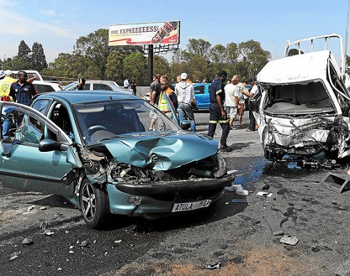
US Road Accidents Data Visualization and Analysis
Olufemi Babalola
Practicum II

Slide 2


Overview
The US Accidents data is a countrywide traffic accident dataset, which covers 49 states of the United States. The data is continuously being collected from February 2016 to March 2019 and consists of 2.974 million rows with 49 variables.

Slide 3

Objective
With data visualizations, this study attempts to analyze various causes of accidents.
Some include (but are not limited to):
bar weather conditions
poor visibility
traffic objects
road conditions i.e. weather
The severity of these occurrences was also analyzed. I also tried to figure out the states with high and low accidents.

Slide 4
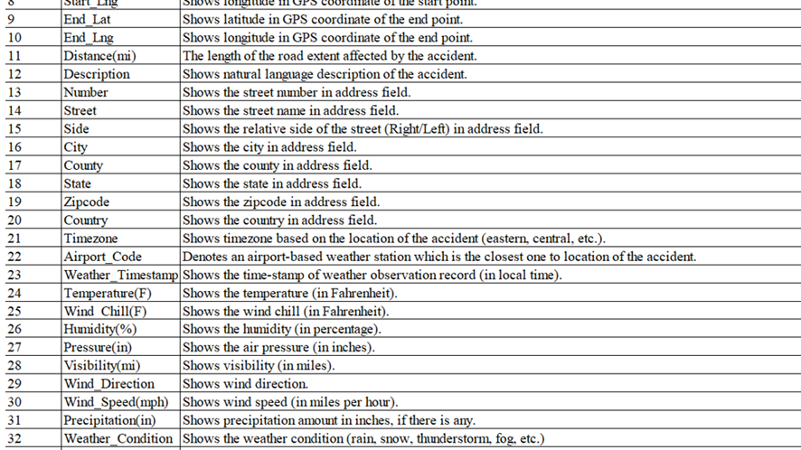
Description of the dataset

Slide 5
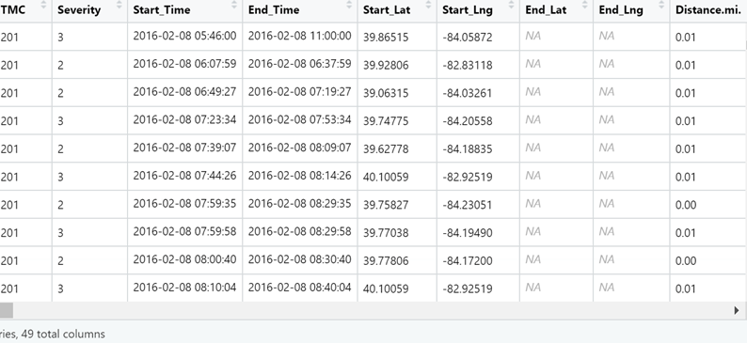
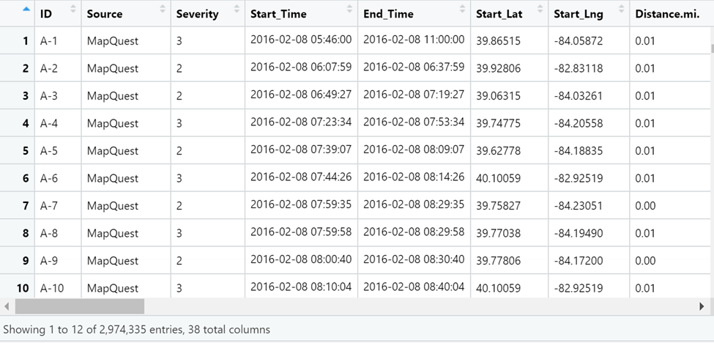
Removing Missing Values

Slide 6
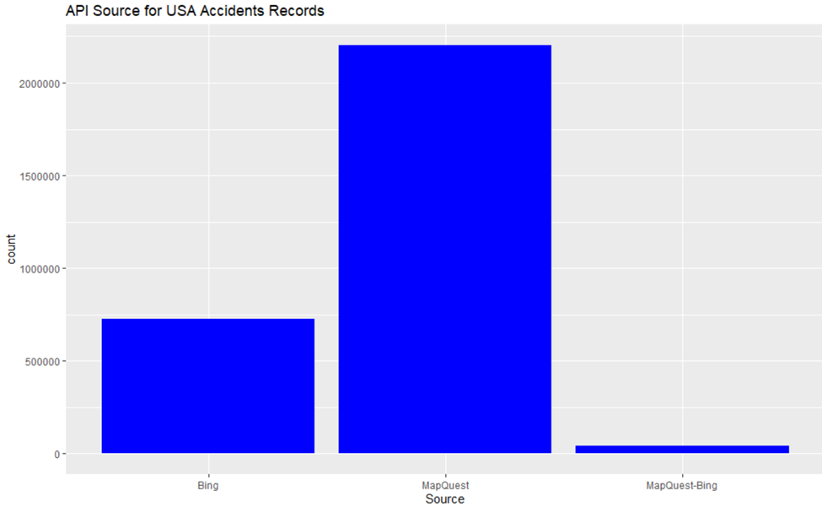
API Source of Accidents dataset
There are only three API sources that reported the accidents. It can be observed that most of the accidents(around 1,700,000) were reported by MapQuest, followed by Bing.

Slide 7
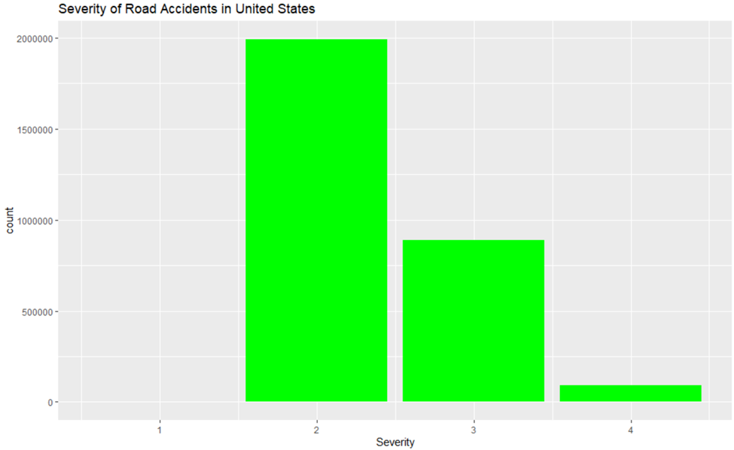
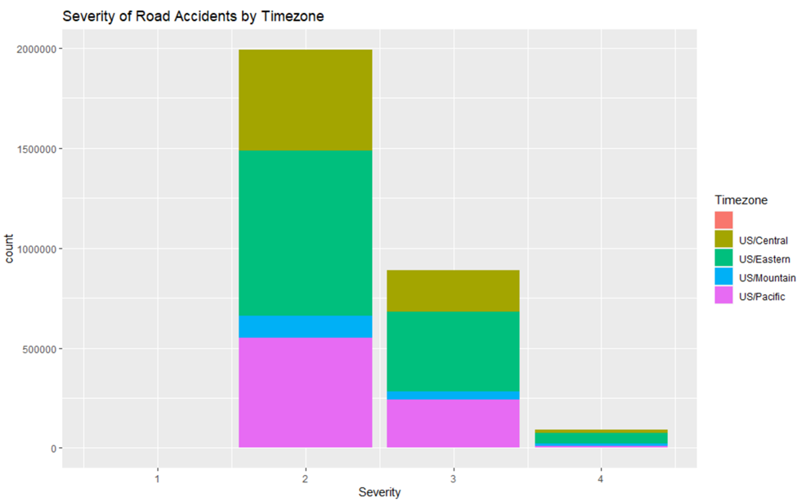
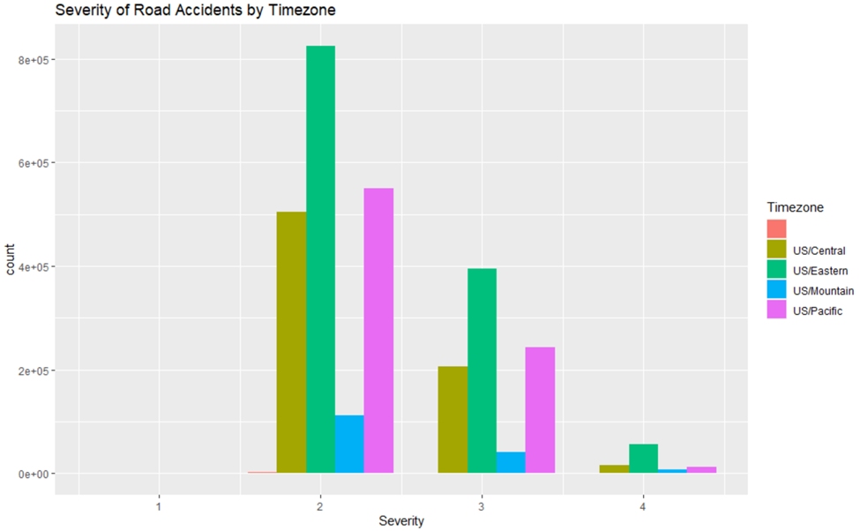
Severity of the Road Accidents

Slide 8
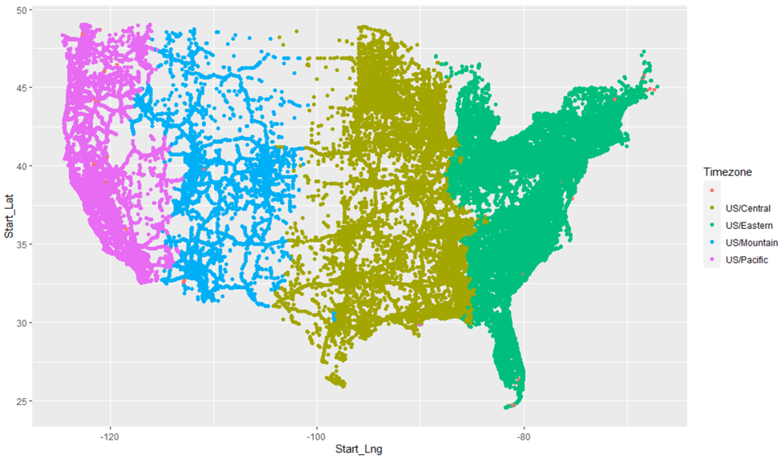
Accidents spread by Time Zones
The Start_Lat and Start_Lng were used to get the exact location of the accidents.

Slide 9
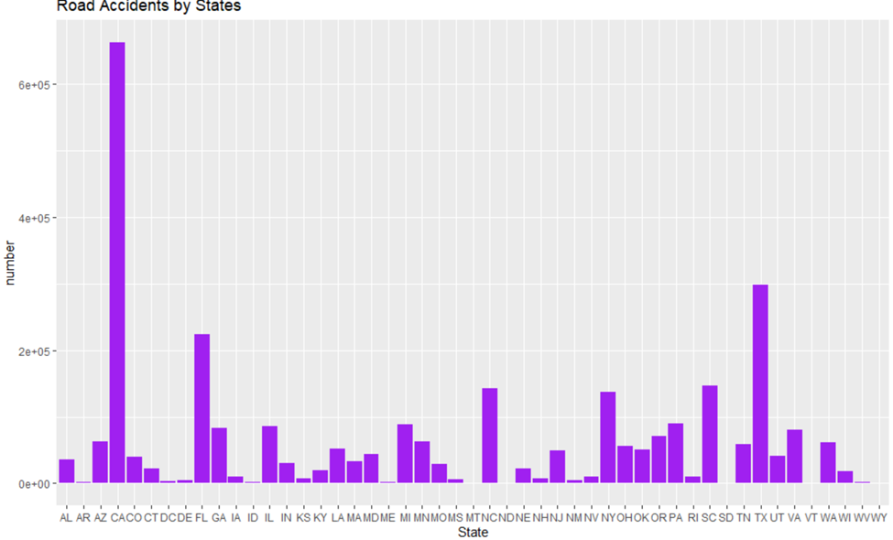
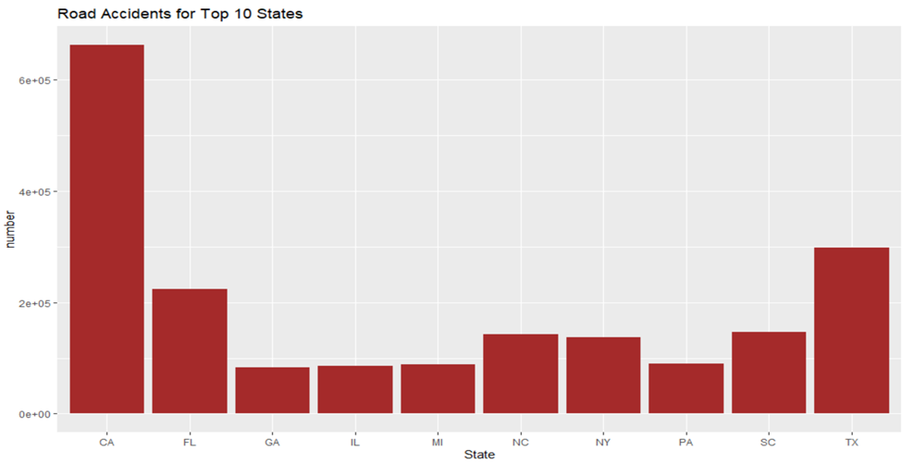
Ranking by States
The plot illustrates that California (CA) has the greatest number of accidents followed by Texas (TX) and Florida (FL). The number of accidents in California is almost twice the number of accidents in Texas.

Slide 10
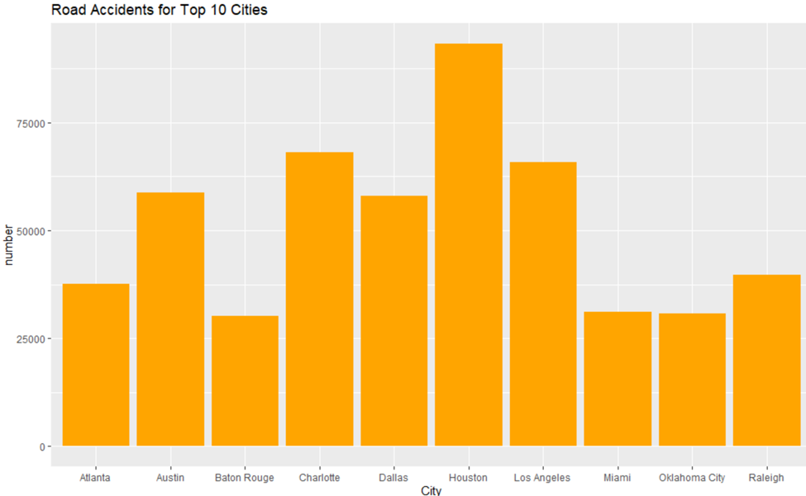
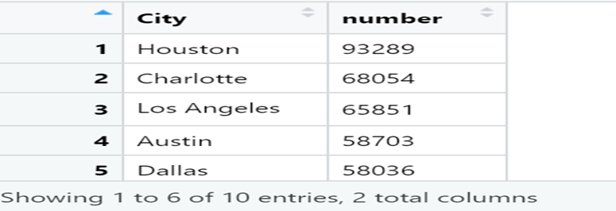
Ranking by Cities
From this plot, we can see that most of the accidents occured in Houston, followed by Charlotte and Los Angeles.

Slide 11
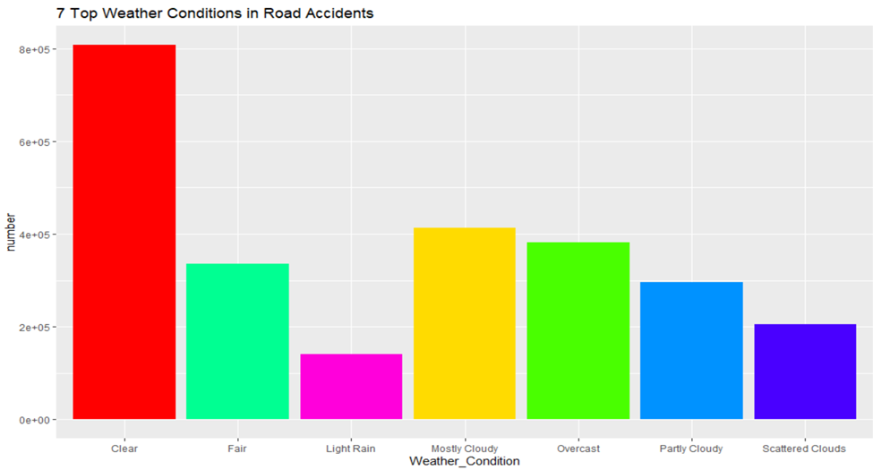
Weather Conditions effects on Road Accidents
The plot shows that the weather condition for most of the accidents were clear, followed by mostly cloudy and overcast. Overcast and mostly cloudy are reasonable factors for accidents unlike clear, which means that weather conditions does not play an important role.

